Slide 1
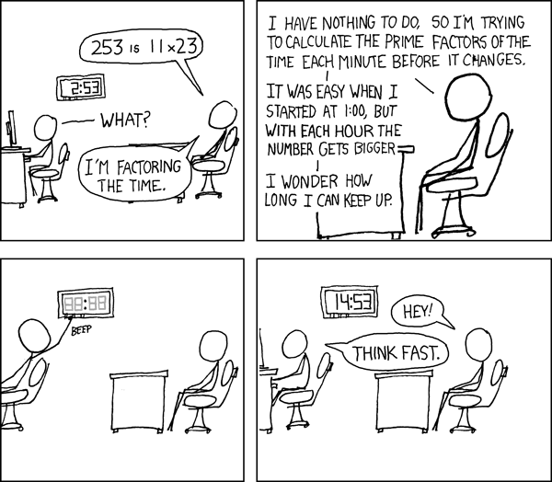
Division in Rings
Petr Samodelkin
Elias Köhnlein

Slide 2
The Definitions

Slide 3
Definition 1. Divides:
Mathematical Expression
Lean Code
We define x | y if ∃a, y = a · x
def Divides (x y : R) : Prop :=
∃ a, y = a * x
notation x " | " y => Divides x y

Slide 4



Definition 2. Unit:
Mathematical Expression
Lean Code
We say a is a unit, if it's invertible in R, in other words,
In-Built:
a is a unit, if there’s an element of , which is the unit group of R, which equals a.
Elements of have double-sided inverses by definition.

Slide 5
Definition 2. IsAssociated:
Mathematical Expression
Lean Code
x and y are associated if there exists a unit a, such that:
y = a · x
Being associated is an equivalence relation, easy to see if you multiply both sides by the inverse of a.
def IsAssociated (x y : R): Prop :=
∃ (a : R), y = a * x

Slide 6
Definition 3. IsNontrivial:
Mathematical Expression
Lean Code
x ≠ 0
x is nontrivial if and ¬(IsUnit x)
def IsNontrivial (x : R) Prop := x ≠ 0 ∧ ¬(IsUnit x)

Slide 7
Definition 4. IsIrreducible:
Mathematical Expression
Lean Code
x is irreducible, if
x is nontrivial, and
for any a, b in R, such that a*b=x, one of them is a unit. In other words, it cannot be factored in 2 non-unit elements.
def IsIrreducible (x : R) : Prop :=
IsNontrivial x ∧ ∀ a b,
x = a * b →
IsUnit a ∨ IsUnit b

Slide 8
Definition 5. IsPrime:
Mathematical Expression
Lean Code
x is prime if
x is nontrivial, and
Euclid’s lemma applies:
If x divides ab, it divides either a or b.
def IsPrime (x : R) : Prop :=
IsNontrivial x ∧ ∀ a b, (x | a * b) → (x | a) ∨ (x | b)

Slide 9
Definition 6. IsFactorialRing:
Mathematical expression
Lean code:
A ring R is factorial if:
It’s an integral domain
every non-zero, non- unit element is factorable into irreducibles
such factorization is unique up to associates and permutation
Wait for it…

Slide 10
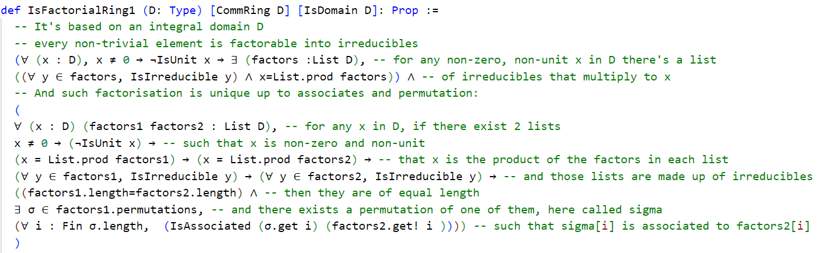
Definition 6. IsFactorialRing: Lean
Mathematical expression
Lean code:
for it…

Slide 11
The Lemma‘s
Lean 4

Slide 12
Lemma 1. Zero of Zero Divides:
Lemma
Proof
If 0 | x, then x = 0
Suppose 0 | x. Then, there exists a such that x = a·0. Hence, x = 0
Lean Code
lemma zero_of_zero_divides (x : R) (hx : 0 | x) :
x = 0 := by
obtain ⟨a, ha⟩ := hx
simpa using ha
Notes:
Example: If x = 5, then 0 | x implies x = 0, which contradicts x = 5. Therefore, x = 0

Slide 13
Lemma 2. Everything Divides Zero:
Lemma
Proof
x | 0 for any x
Let x be any element. Then,
0 = 0 · x, so x | 0 by definition
Lean Code
lemma everything_divides_zero (x : R) : x | 0 := by
use 0
simp
Notes:
Example: For x = 7, 7 | 0 since 0 = 0 · 7

Slide 14
Lemma 3. Non-zero Divisors:
Lemma
Proof
If y ≠ 0 and x | y, then x ≠0
Let y ≠ 0 and x | y.
Assume x = 0.
=> 0 | y implies y = 0 by Lemma 1,
Contradicting y ≠ 0.
Lean Code
lemma ne_zero_of_divides_of_ne_zero (x y : R) (hy : y ≠ 0) (hxy : x | y) : x ≠ 0 := by
intro hx
subst hx
exact hy (zero_of_zero_divides y hxy
Notes:
Example: For y = 10 ≠ 0 and x = 2, x | y. Hence, x ≠ 0

Slide 15
Lemma 4. Associated Elements:
Lemma
Proof
x is associated with itself
Take a = 1. Then, x = 1 · x, so x is associated with x
Lean Code
lemma isAssociated_of_eq (x : R) : IsAssociated x x := by
use 1
simp
Notes:
Example: For x = 3, x = 1 · x shows x is associated with x.

Slide 16
Lemma 5. Divides of Associated Elements:
Lemma
Proof
If x and y are associated, then x | y and y | x
Assume y = a · x. Then, x | y. Also, x = a⁻¹ · y implies y | x
Lean Code
lemma divides_divides_of_isAssociated (x y : R) (h : IsAssociated x y) :
(x | y) ∧ (y | x) := by
obtain ⟨a, ha⟩ := h
constructor
· use a
· use a.inv
rw [ha]
simp
Notes:
For y = 6 and x = 2, if y = 3 · x, then x | y and y | x

Slide 17

Lemma 6. Associated Elements in a Domain :
Lemma
Lean Code
If R is a domain, x | y, and y | x, then x and y are associated
Proof
If x = 0, then y = 0 by Lemma 1, so x is associated with y.
If x ̸ = 0, then there exist a and b such that y = a · x and x = b · y.
This implies a · b = 1. Since a · b = 1, a and b are units.
Therefore, y = a · x, so x is associated with y.
Notes:
Example: For x = 6 and y = 2 × 3, if y = 2 · 3 · x and x = (1/2 × 1/3) · y, then x and y are associated

Slide 18
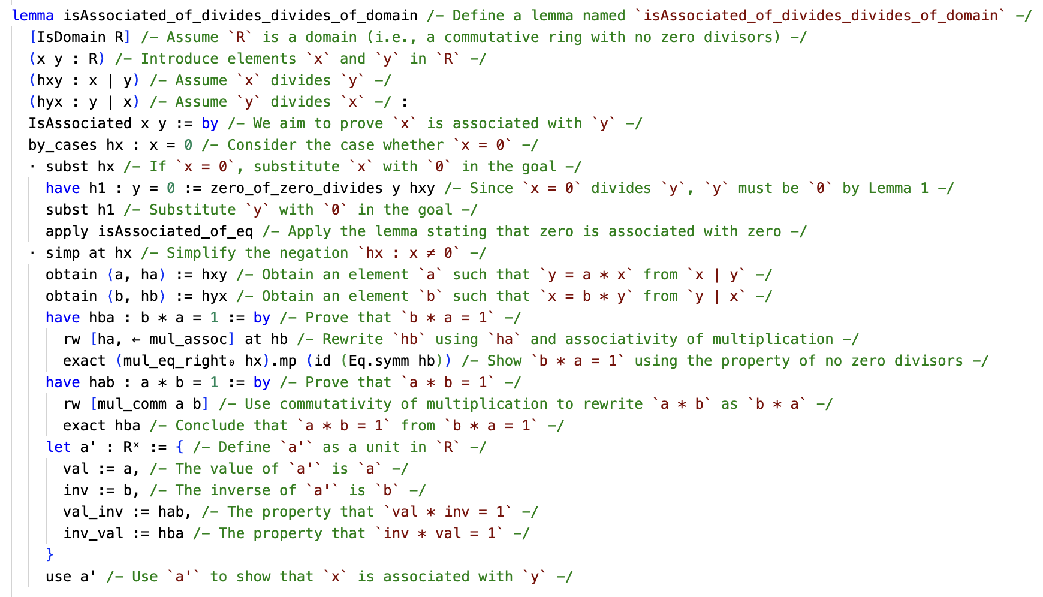

Slide 19
Lemma 7. Associated Elements iff Divides in a Domain:
Lemma
Proof
In a domain R, x and y are associated if and only if x | y and y | x
By Lemma 5 and Lemma 6
Lean Code
lemma isAssociated_iff_divides_divides_of_domain [IsDomain R] (x y : R) :
IsAssociated x y ↔ (x | y) ∧ (y | x) := by
constructor
· exact divides_divides_of_isAssociated x y
· intro ⟨hxy, hyx⟩
exact isAssociated_of_divides_divides_of_domain x y hxy hyx
Notes:
For x = 3 and y = 9, if x | y and y | x, then x and y are associated

Slide 20
Lemma 8. Multiplication Left Equality:
Lemma
Proof
If a = b, then c · a = c · b
By the properties of multiplication, c · a = c · b
Lean Code
lemma ca_equals_ba [IsDomain R] {a b c: R}
(h: a = b) : c*a = c*b := by
apply mul_eq_mul_left_iff.mpr
apply Or.inl
exact h
Notes:
If a = b = 2 and c = 3, then c · a = c · b = 6

Slide 21
Lemma 9. Multiplication Right Equality:
Lemma
Proof
If a = b, then a · c = b · c
By the properties of multiplication, a · c = b · c
Lean Code
lemma ac_equals_bc [IsDomain R] {a b c: R}
(h: a = b) : a*c = b*c := by
apply mul_eq_mul_right_iff.mpr
apply Or.inl
exact h
Notes:
If a = b = 2 and c = 3, then c · a = c · b = 6

Slide 22
Lemma 10. Unit of Multiplication Equals One:
Lemma
Lean Code
If x = a · b, x is nontrivial, and x | a,
then b is a unit
Proof
Assume x = a · b, x is nontrivial, and x | a.
Then, there exists c such that a = c · x.
Substituting x gives x = a · b = (c · x) · b.
Since R is a domain, we can cancel x (because x ≠ 0), leading to 1 = c · b. Therefore, c and b are units, so a is a unit
Notes:
If a = b = 2 and c = 3, then c · a = c · b = 6

Slide 23
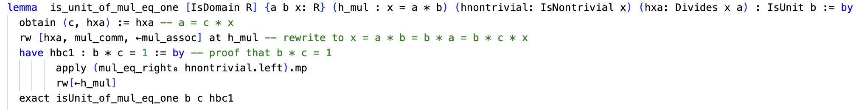

Slide 24
The two Theorems

Slide 25
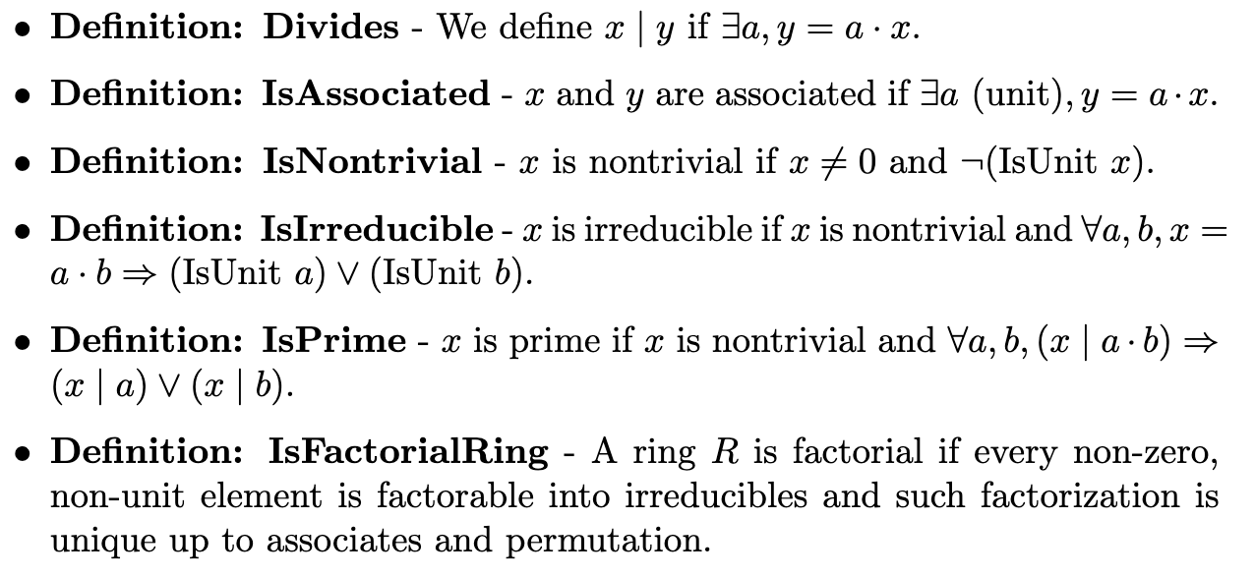
Overview of the definitions and lemmas

Slide 26
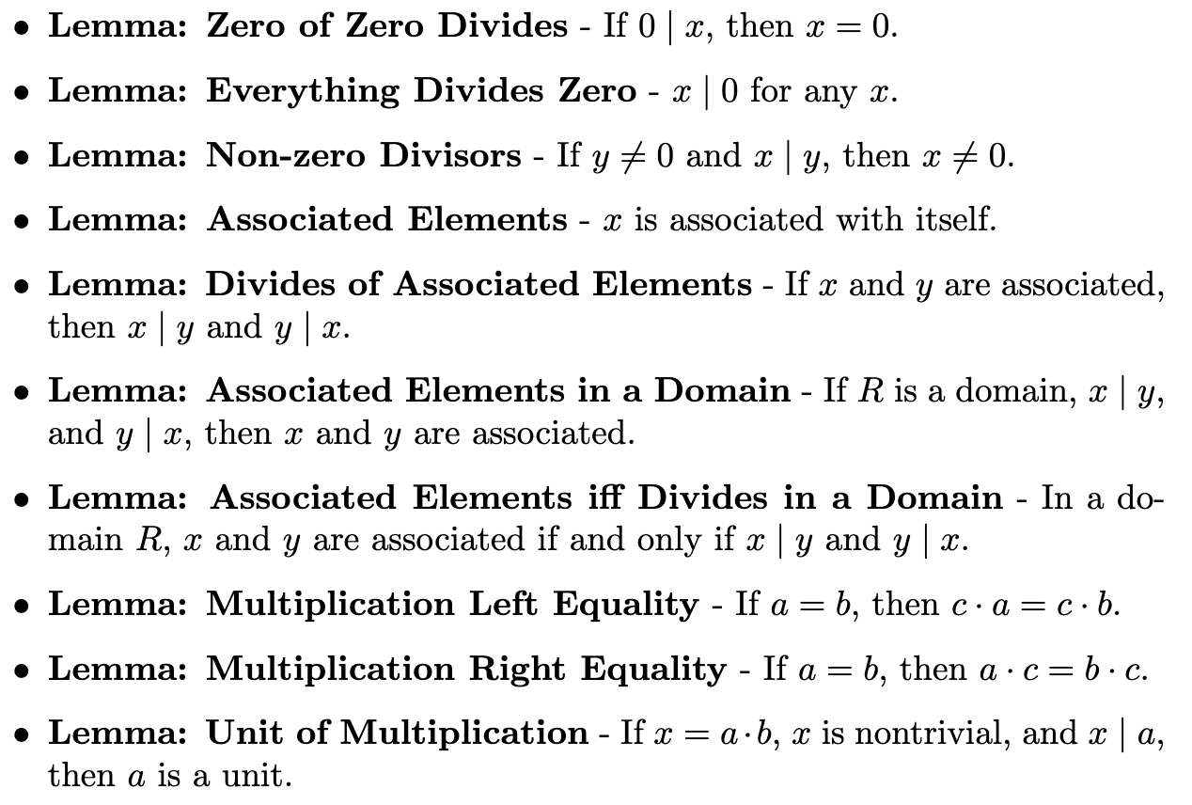
Overview of the definitions and lemmas

Slide 27

Definition 6. IsFactorialRing:
Mathematical Expression
Lean Code
A ring R is factorial if:
every non-zero, non- unit element is factorable into irreducibles and such factorization is unique up to associates and permutation

Slide 28
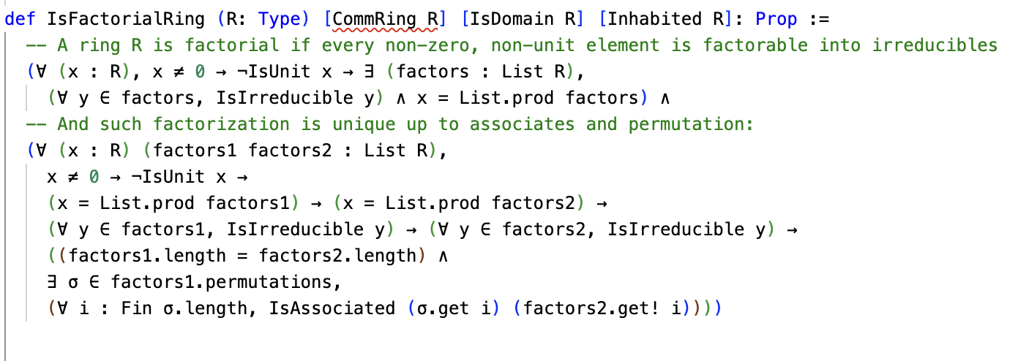

Slide 29
Theorem 1. Every Prime Element is Irreducible in an Integral Domain
Formal Statement:
Let R be an integral domain and x ∈ R.
If x is prime, then x is irreducible.

Slide 30
By definition of primality, x is non-trivial and for all a, b ∈ R, if x | (a · b), then x | a or x | b. We need to show that x is irreducible.
That is, x is non-trivial and for any a, b ∈ R, if x = a · b, then a or b is a unit.
1. Since x is prime, it is non-trivial, i.e., x ≠0 and x is not a unit. 2. Suppose x = a · b for some a, b ∈ R. Since x | (a · b), by the primality of x, x | a or x | b. 3. Without loss of generality, assume x | a. Then, there exists c ∈ R such that a = c · x.
4. Substituting a = c · x in x = a · b, we get x = (c · x) · b. 5. Since R is an integral domain and x ≠0, we can cancel x from both sides to obtain 1 = c · b, which implies b is a unit.
Therefore, x is irreducible

Slide 31
1. Since x is prime, it is non-trivial, i.e., x ≠0 and x is not a unit.
2. Suppose x = a · b for some a, b ∈ R. Since x | (a · b), by the primality of x, x | a or x | b.
3. Without loss of generality, assume x | a. Then, there exists c ∈ R such that a = c · x.
theorem isIrreducible_of_isPrime [IsDomain R] (x : R)
(h : IsPrime x) : IsIrreducible x := by
obtain ⟨hnontrivial, hdiv⟩ := h
constructor
· exact hnontrivial
· intros a b h_mul
have hx_divides_ab : x | a*b := by
use 1
rw[h_mul]
Simp
have hxa_or_xb := hdiv a b hx_divides_ab
-- x divides either a or b because it's prime
rcases hxa_or_xb with hxa | hxb

Slide 32
4. Substituting a = c · x in x = a · b, we get x = (c · x) · b.
5. Since R is an integral domain and x ≠0, we can cancel x from both sides to obtain 1 = c · b, which implies b is a unit.
Therefore, x is irreducible
· exact Or.inr (is_unit_of_mul_eq_one h_mul hnontrivial hxa)
· have h_mul1 : x = b * a := by
rw[mul_comm]
exact h_mul
exact Or.inl (is_unit_of_mul_eq_one h_mul1 hnontrivial hxb)

